Slide 1
Building A Collaborative Community Response Action Plan
Scott B. Hesseltine, MA, MBA, LCADC
Vice President of Addiction Services
Centerstone Kentucky
July 18, 2019

Slide 2
Working with Communities to Address the Opioid Crisis
SAMHSA’s State Targeted Response Technical Assistance (STR-TA) grant created the Opioid Response Network to assist STR grantees, individuals and other organizations by providing the resources and technical assistance they need locally to address the opioid crisis .
Technical assistance is available to support the evidence-based prevention, treatment, and recovery of opioid use disorders.
Funding for this initiative was made possible (in part) by grant no. 6H79TI080816 from SAMHSA. The views expressed in written conference materials or publications and by speakers and moderators do not necessarily reflect the official policies of the Department of Health and Human Services; nor does mention of trade names, commercial practices, or organizations imply endorsement by the U.S. Government.

Slide 3
Working with Communities to Address the Opioid Crisis
The Opioid Response Network (ORN) provides local, experienced consultants in prevention, treatment and recovery to communities and organizations to help address this opioid crisis.
The ORN accepts requests for education and training.
Each state/territory has a designated team, led by a regional Technology Transfer Specialist (TTS), who is an expert in implementing evidence-based practices.

Slide 4
Contact the Opioid Response Network
To ask questions or submit a request for technical assistance:
    Visit www.OpioidResponseNetwork.org
    Email orn@aaap.org
    Call 401-270-5900

Slide 5
Goals for Today
Collaboration in New Ways
Community/Relationship Building
Innovative Solutions
Commitment to Change
Action

Slide 6
It’s Everyone’s Issue
Etiology of the Epidemic – How We Got Here
Role of Trauma and ACE’s
Supportive Role of Employers
Supportive Role of HR, Policies, & Procedures
Role of Treatment Providers
Role of Community

Slide 7
Workplace Impact OUD/SUD
Safety – opioid use and workplace injury
Absenteeism – individuals with OUD miss 50% more work than general workforce¹
Productivity – Cost more than $400 Billion in workplace productivity in the United States²
Retention - 42% of people with OUD worked for more than 1 employer in past year¹
Heathcare Spend – Costs 3x higher for employees who misuse prescription drugs¹
10B2B International (2017, January) National Employer Survey Prescription Drugs & The US Workforce [Powerpoint Slides]. Retrieved from https://www.nsc.org/Portals/0/Documents/NewsDocuments/2017/ National-Employer-Addiction-Survey-Methodology.pdf?ver=2018-07-05-105114-883
4Substance Abuse and Mental Health Services Administration (2019, January 1) Recovery and Recovery Support. https://www.samhsa.gov/find-help/recovery

Slide 8
Workplace Impact - Recovery
Employees in recovery have lower healthcare costs.
10% fewer missed work days than the general workforce
8% less turnover than the general workforce.
10B2B International (2017, January) National Employer Survey Prescription Drugs & The US Workforce [Powerpoint Slides]. Retrieved from https://www.nsc.org/Portals/0/Documents/NewsDocuments/2017/ National-Employer-Addiction-Survey-Methodology.pdf?ver=2018-07-05-105114-883

Slide 9
Key Employer Tools
Data Analytics
Benefit Utilization
Policies and Workplace Culture
Community Collaborations

Slide 10
Key Employer Tools
Using data to understand employee characteristics
  Medical and pharmacy spend
  Top conditions and medications
  Top mental health and SUD expenditures
Treatment & Recovery
  SUD diagnosis
  Access to treatment benefits
  Examine benefit package: coverage limitations, cost sharing, utilization management

Slide 11
Key Employer Tools
Role of Policies and Workplace Culture
  Educate employees and supervisors
  Create a culture of support, reduce stigma
  Develop workplace drug and alcohol policy
  Implement effective and privacy sensitive drug testing
Treatment & Recovery Supports
Flexible scheduling and leaves of absence
Provide support group resources
Develop a return to work policy

Slide 12
What Do We Do With All This Information?

Slide 13
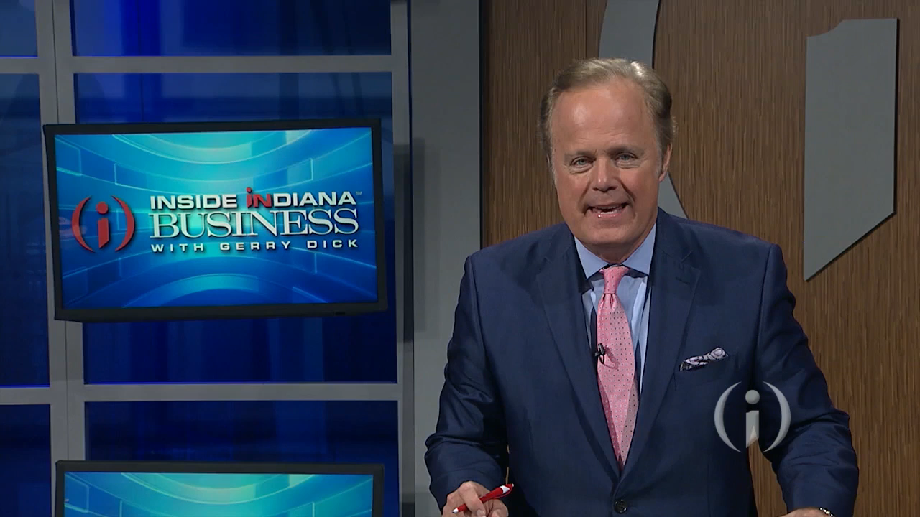
Video
Notes:
Belden Video here

Slide 14
Centerstone Workforce Investment Model
Pathway to Employment
Collaboration Between CMHC and Employer
Guaranteed FT Employment
Customized Solutions for Employers

Slide 15
INTO ACTION
Group Exercise
Develop Concrete Next Steps
Commitment to Continuing the Work

Slide 16
GALLERY WALK
Notes:
We will conduct a Gallery Walk here where we break groups into 5 distinct groups based upon size,
Each group will designate a recorder and reporter whose responsibility will be to write out group answers and report out to the larger group at the end
On the wall in the room there are 5 areas each with a different question hanging on the wall on flip chart paper related to the challenges and solutions that have been discussed throughout the day.
They are given 2-3 minutes at each station to formulate the groups response and the recorder writes it on the flip chart paper
When groups have been to all stations the reporter for each group will read out the answer their group decides upon as the best answer for that question.
All of the gallery walk flip charts will be photographed and sent along with the other follow up information:

Slide 17
TABLE TOP EXERCISE
Notes:
In the same groups the participants will work together to collaboratively complete the blank work plan template. They will be given 10-15 minutes to complete the exercise and the reporter for each group will present to the larger group their action steps.
During this exercise the teams will be encouraged to add their name to a flipchart list on the wall. This is the formation of regional task force or ad hoc workgroup that is going to make a commitment to continue with the work and momentum begun today. One person is hopefully going to be the one to take ownership of the process moving forward.
All materials, work plans, gallery walk questions and the task force list will be emailed to Kate for wider distribution to their conference list.

Slide 18
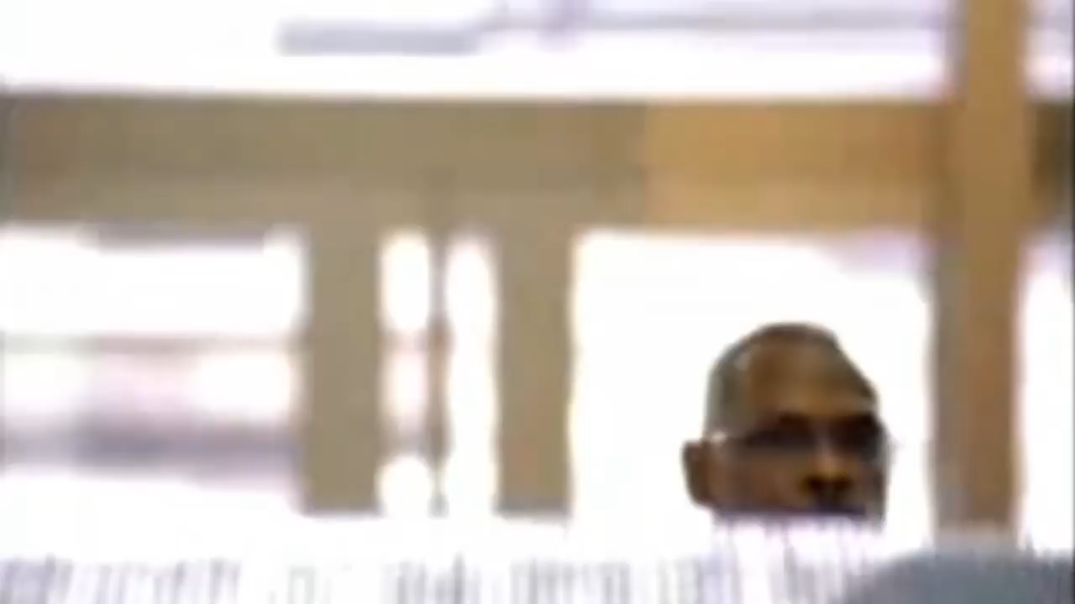
video
Notes:
Stuck on an escalator video here

Slide 19
SUMMARY
It’s Everyone’s Issue
Continue To Collaborate
Keep the Momentum
Hold the Vision

Slide 20
THANK YOU!!

